Slide 1
Three dimensional Knapsack problems
Phase 1.3, group 2

Slide 2
contents
Problem description
Possible solutions
Algorithm that we used
3D visualization
Results for boxes
Results for pentominoes
Conclusions

Slide 3
Problem description
This project is about solving a three dimensional knapsack problem:
A cargo-space (with dimensions 16.5 x 2.5 x 4.0 ) has to be filled with parcels of different sizes and values in a way that the maximum value is reached
Boxes as parcels: A: 1.0 x 1.0 x 2.0; B: 1.0 x 1.5 x 2.0; C: 1.5 x 1.5 x 1.5
Pentominoes as parcels: each block of the letter being a square of 0.5
user friendly interface to decide on the variety and amount of different parcels
Questions:
a/c) is it possible to fill the complete cargo- space with the parcels?
b/d) what is the maximum value that you can store in your cargo-space if the parcels represent values of 3, 4 and 5 unites respectively?

Slide 4
Possible solutions
Backtracking algorithm as a solution for a)/c):
→ goes trough every possible combination of parcels to check if the space can be filled completely
Greedy algorithm as a solution for b)/d):
→ decides step by step what the highest value for the next few coordinates is and puts the parcel there if it fits
Dynamic programming as a solution for b)/d):
→ divides the problem into smaller tasks and solves them first in order to combine them recursively

Slide 5
Algorithm that we used: Greedy algorithm
Reason for our choice:
Easier than other algorithms
Fast
Sorting method 1: density of boxes (density = value * 100 / volume)
Sorting method 2: insertion sort according to density

Slide 6
Pseudocode for the sorting method
INPUT: unsorted array
OUTPUT: new sorted array
FOR (each box in the array from front to back)
FOR (the current box check from back to front (because it still might not be in order))
IF (density of current box > density of next box)
switch the indexes of the boxes
RETURN the sorted array

Slide 7
Pseudocode for the solve method
FOR (each element in the array boxes)
FOR (the next x- coordiante which is still in the truck)
FOR (the next y- coordiante which is still in the truck)
FOR (the next z- coordiante which is still in the truck)
IF (box is still available)
FOR (the current rotation)
IF (it fits in the empty space of the truck) place the box
ELSE try next x- rotation
IF (each x- rotation tried) rotate once on y- axes
IF (each y- rotation and all possible x- rotations tried) rotate once on z- axes

Slide 8
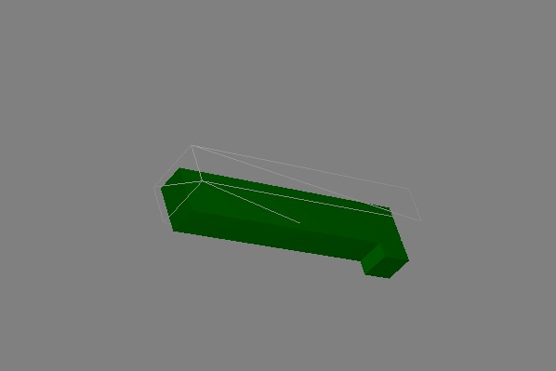
3D visualization

Slide 9
results for boxes: Can the cargo- Space be filled completely?
Only boxes of type A, B or C can not fill the space due to the size of these boxes:
Dimensions of boxes A: 1.0 x 1.0 x 2.0 cannot fill the width of 2.5 m
Dimensions of boxes B: 1.0 x 1.5 x 2.0 cannot fill the length of 16.5 m at the same time with filling out the 2.5 m width
Dimensions of box C: 1.5 x 1.5 x 1.5 cannot fill the height of 4.0 m

Slide 10
results for boxes: Can the cargo- Space be filled completely?
A and B
A and C
B and C
A, B and C

Slide 11
Results for Boxes: Maximum value of Cargo- space
Maximum value: 230 units, achieved with
0 boxes of type A
26 boxes of type B
22 boxes of type C
due to the greedy algorithm the only box chosen would be type A, if there would enough boxes of it
this can be achieved by using 4m as the depth, 2.5m as the height and 16.5m as the width

Slide 12
results for pentominoes: Can the cargo- Space be filled completely?

Slide 13
results for pentominoes: Can the cargo- Space be filled completely?

Slide 14
Results for Pentominoes: Maximum value of Cargo- space

Slide 15
conclusions
Changing the order of the cargo- space changes the amount of boxes which fit in it
→ changes the total value of the content of the space

Slide 16
Group 2: wouter van elteren, kim roggenbuck, tobias mersch, hao yun

